Slide 1
So you Want to use
Motic Images Plus
Dazzle your students!
Earn millions!
Impress that special someone!

Slide 2
Get Started:
Open the program by clicking on this icon

Slide 3
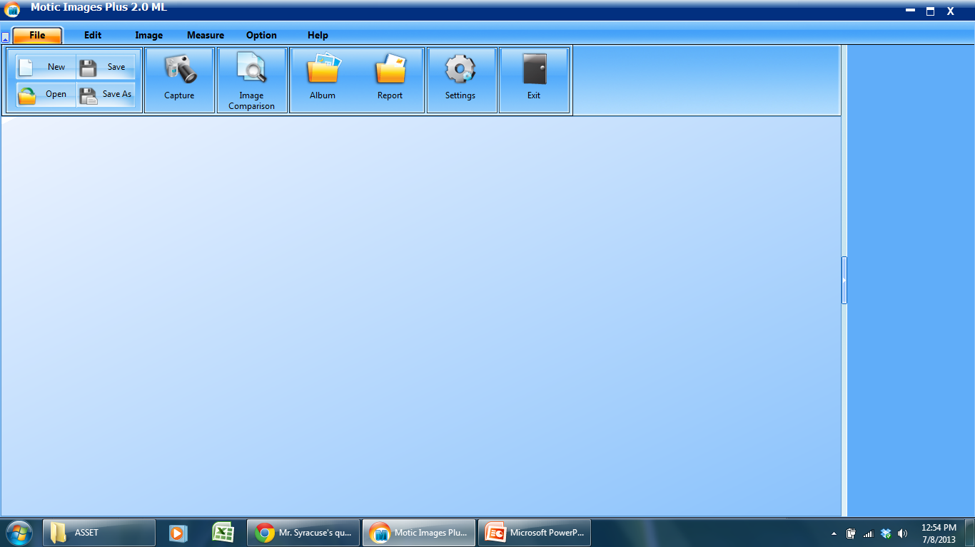
The Main Screen:

Slide 4
The File Tab:
Click to get the live feed from your ‘scope

Slide 5
Enable all “auto” options for best picture quality.

Slide 6
Capture still pictures or video. Just click!
Or right-click the live image to capture.

Slide 7
The File Tab:
Click to compare two previously-captured images side-by-side

Slide 8
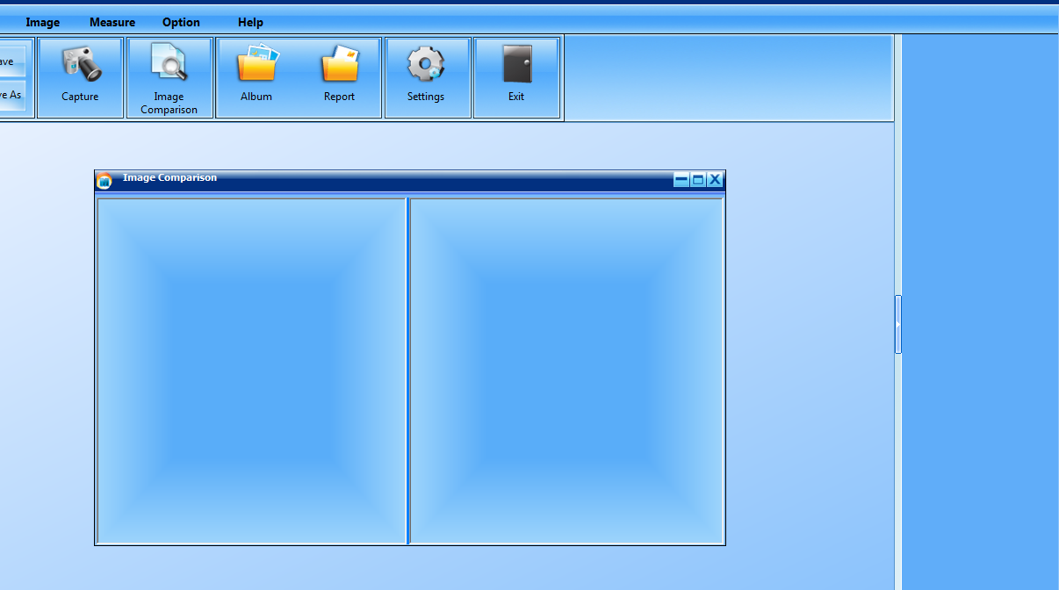
Drag images into comparison window to view them.

Slide 9
The File Tab:
See where all your captured images are saved

Slide 10
The File Tab:
Adjust auto-capture settings, and the file type of your captures.

Slide 11
Set file type
Auto capture frequency

Slide 12
The Edit Tab:
Same functions as in Microsoft word…

Slide 13
The Edit Tab:
Put a shape around a part of your image to point it out to students

Slide 14
The Image Tab:
Adjust color settings

Slide 15
The Image Tab:
Reverses colors for better contrast

Slide 16
The Image Tab:
Add filters to count cells, increase contrast, view organelles…

Slide 17
The Measure Tab:
Different shapes you can measure.

Slide 18
The Measure Tab:
First, you must tell your computer how many micrometers there are in one pixel.

Slide 19
Load an image you’ve taken of a calibration slide.

Slide 20
Indicate what objective you’re using and how big the circle is. Click “Calibrate.”

Slide 21
Name your settings so you can recall them. Select “scale.” Click “save.”

Slide 22
Open the calibration table.
Select your objective lens and click “OK”

Slide 23
Select a measurement tool and measure away!

Slide 24
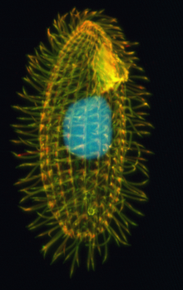
Questions?

