Slide 1
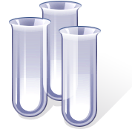
A SYRACUSE SLIDESHOW PRESENTATION
Copyright 2013, all rights reserved.

Slide 2
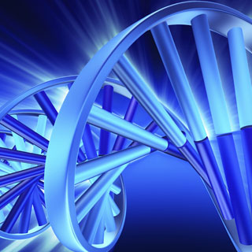
PROTEINS AND NUCLEIC ACIDS
or
BABY, IF YOU UNZIP MY GENES WE CAN MAKE SOME POLYPEPTIDES
D.M. Syracuse, Presenter
TST BOCES
Ithaca, NY

Slide 3
And we begin…
Slide Contents
Something remotely interesting
Some “science” thing

Slide 4
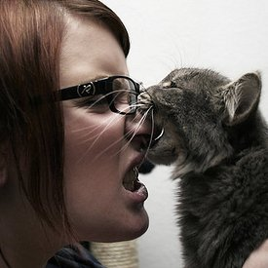
Ask questions…

Slide 5
No yelling at the table
periodic
Carbon is the “backbone” of the
molecules-O-life.
Carbon forms four covalent bonds.
C

Slide 6
No yelling at the table, cont.
Hydrogen can form one covalent bond; oxygen, two.
All of the molecules-o-life contain these three elements (C,H,O)
H
O

Slide 7
One of these things…
Nitrogen and phosphorous set apart some molecules-o-life from others.
Both nitrogen and phosphorous can form three covalent bonds.
N
P

Slide 8
Proteins
or
Polypeptides

Slide 9
Nice to meat you
Proteins are made of many amino acids strung together with covalent bonds.
AA
AA
AA
AA

Slide 10
The Standard 20
There are 20 standard amino acids and a few weird ones.
Selenocysteine incorporates Se.
Pyrrolysine is found in methanogenic bacteria
Many others are used to make other molecules, e.g. Triptophan → Serotonin, Arginine → Nitric Oxide, Glycine → Heme groups
Some are modified by industry, e.g. MSG
Some are modified after transcription!
Proteinogenic
Non-Proteinogenic

Slide 11
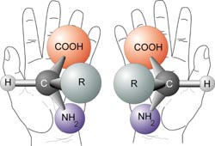
Gotta Hand it to you..
Amino acids have “handedness,” or chirality. This means that they cannot be superimposed on their mirror image.

Slide 12
Southpaws unite!
Almost all the amino acids incorporated into proteins are L-amino acids, not D-amino acids.
Bacterial cell walls contain mostly D-amino acids, though.
L-amino acids dissolve in water much more easily.

Slide 13
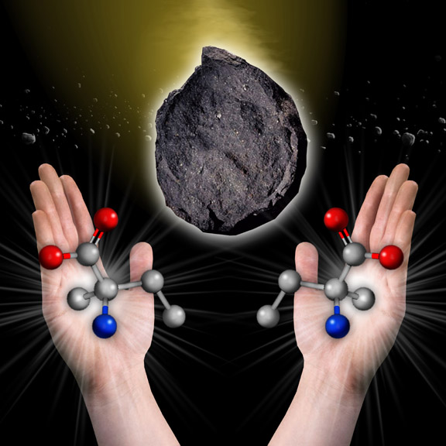
Life from space?

Slide 14
Bond, Peptide Bond.
Amino acids are held to each other with special covalent bonds – peptide bonds.

Slide 15
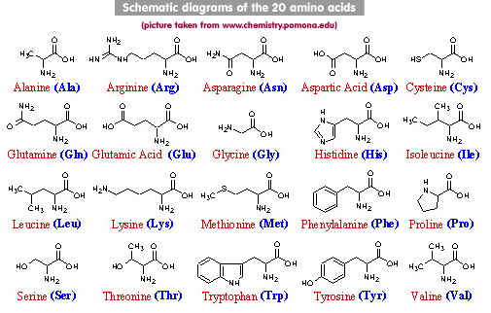
Shake Your R Group, Baby.

Slide 16
Scientific Cuddling
Amino acids in a chain don’t just stay in a chain. They curl up and combine with other chains.
1° structure – straight chain
2° structure – folding to create structures, e.g. zinc fingers, β-pleated sheets, α-helices or coiled coils.
3° structure – Structures interact
4° structure – Combination with other chains.

Slide 17
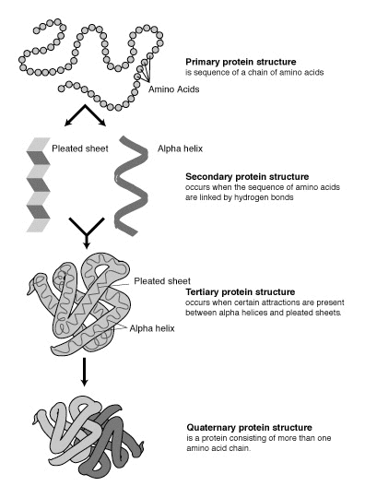
The structures

Slide 18
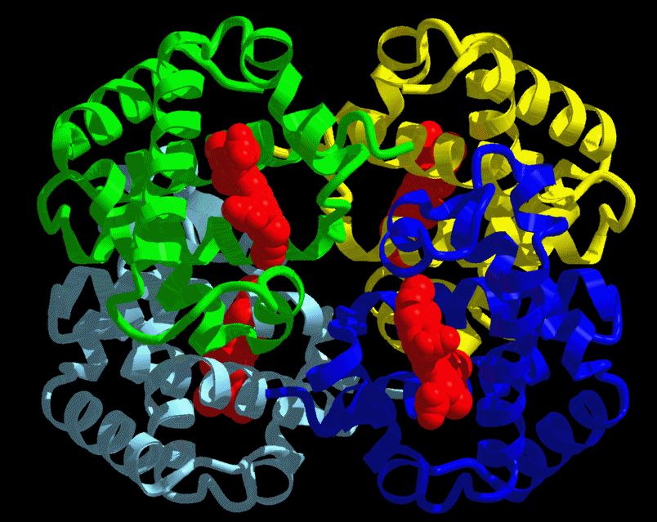
Haemoglobin

Slide 19
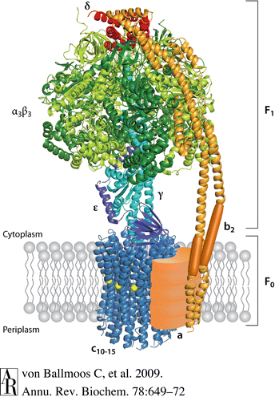
ATP Synthase

Slide 20
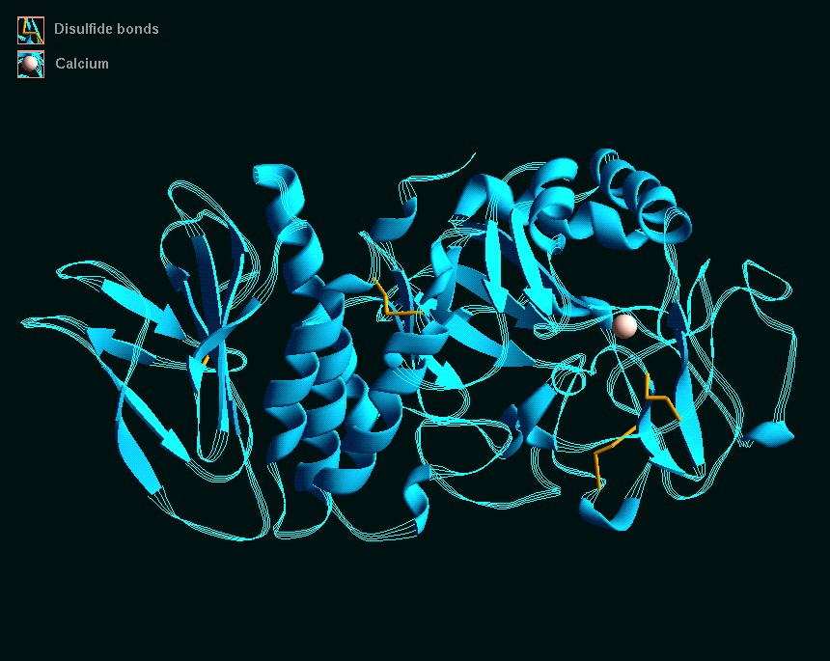
Salivary Amylase

Slide 21
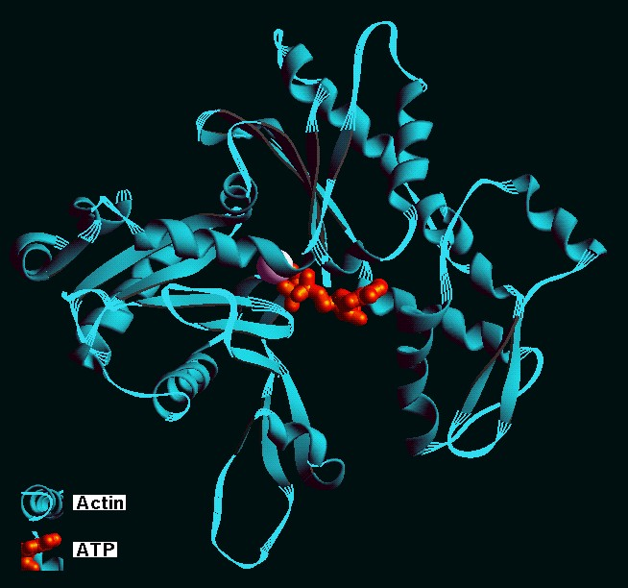
Actin

Slide 22
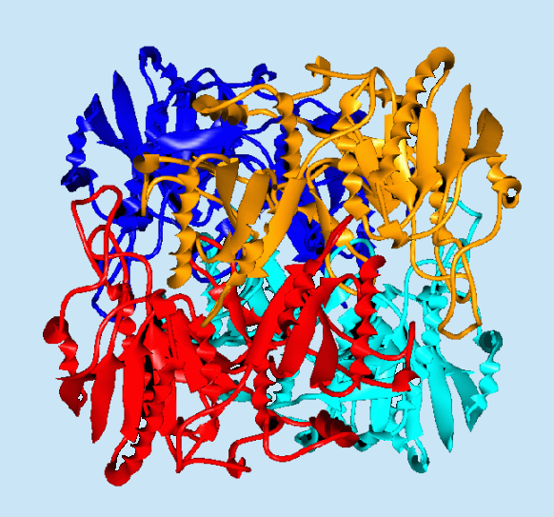
Asparaginase

Slide 23
Functions
Enzymes – duh.
Structure – bacterial cell walls
Movement – actin, myosin
Cell signaling
Immune system
Transport proteins in cell membranes

Slide 24
Ribonucleic Acid
and
Deoxyribonucleic acid

Slide 25
Who lines up the proteins?
Nucleic acids = DNA or RNA
N
Nucleic Acid
Nucleotides
Sugar
Phosphate
Nitrogenous Base

Slide 26
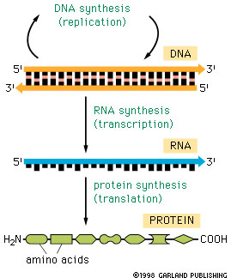
The “Central Dogma”
No dogs allowed

Slide 27
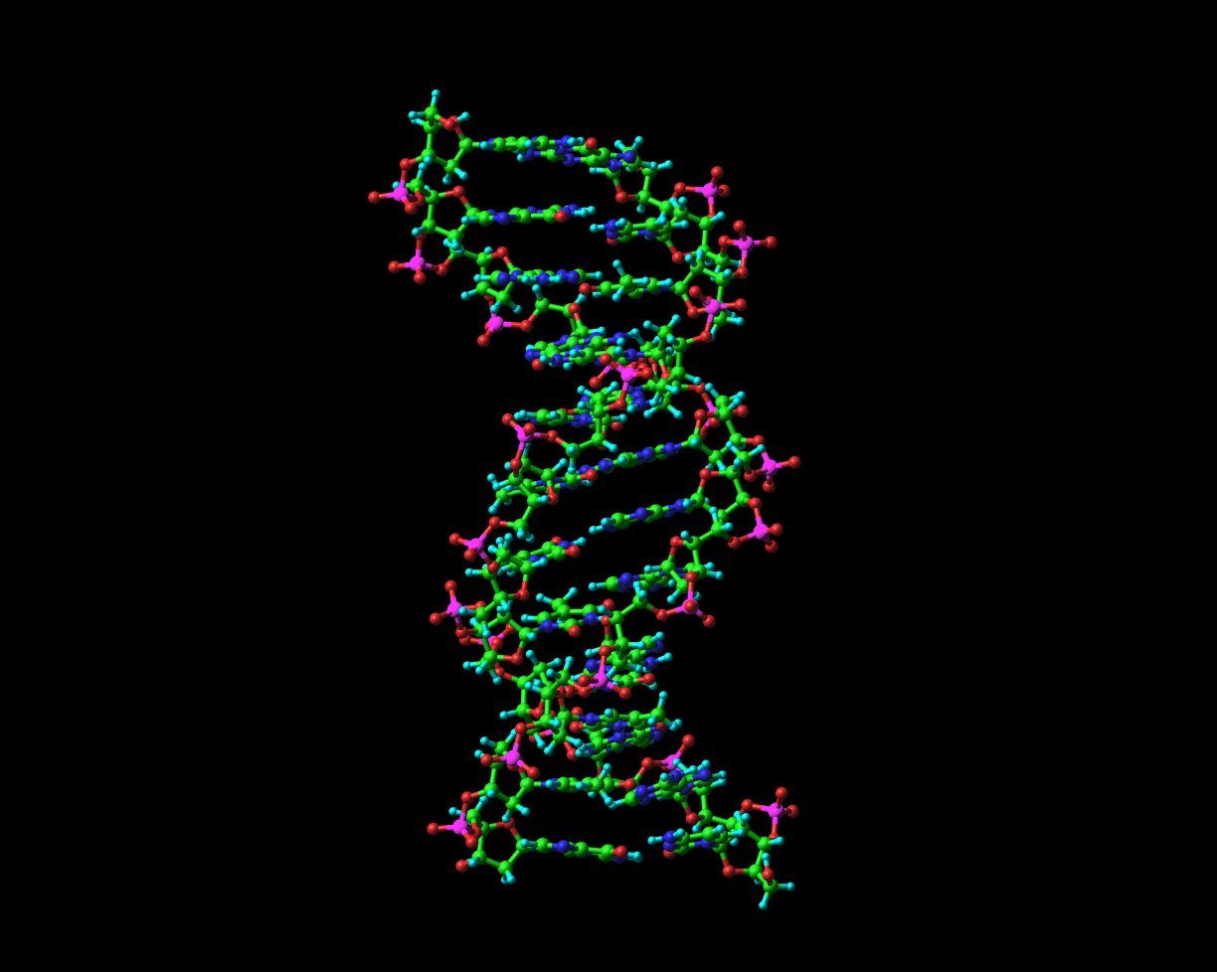
“Le Helix Double”
DNA has a double helix; RNA, a single.

Slide 28
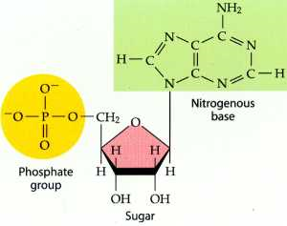
The Nucleotide
Ribose is the sugar in RNA, Deoxyribose is the sugar in DNA.

Slide 29
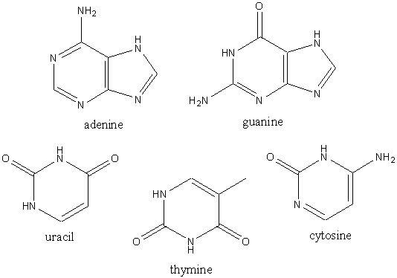
The Nitrogenous Base
RNA – Adenine, Guanine, Cytosine and Uracil
DNA – Adenine, Guanine, Cytosine and Thymine.
Purines
Pyramidines

Slide 30
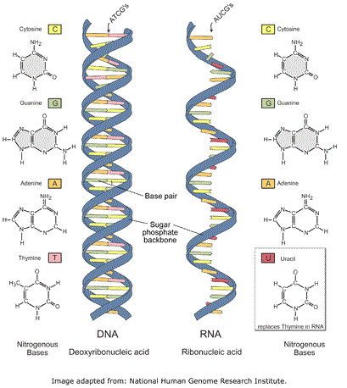
The end is near…
DNA is more robust than RNA.
Why build a “wimpy” molecule?

Slide 31
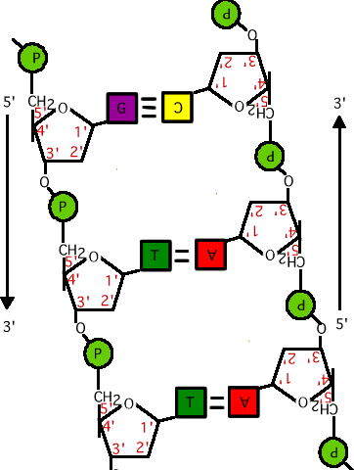
DNA is Antiparallel
Named for carbon locations.
Implications for DNA replication/transcription.

Slide 32
YOU CAN ONLY ADD DNA TO THE 3’ END!

Slide 33
DNA is faithful!
Error rate of 1 mistake in 1,000,000 to 100,000,000 nucleotides copied.
At about 3 billion bases, that’s as many as 3,000 errors for each replication! NG!
Enzymes (made of proteins) can fix these errors
Some errors are necessary – Evolution.
The capacity to blunder slightly is the real marvel of DNA. Without this special attribute, we would still be anaerobic bacteria and there would be no music.
-- Lewis Thomas

Slide 34
The dénoument
DNA codes for RNA (transcription).
RNA codes for proteins (translation).
Proteins can make pretty much anything (awesome).
Structure is directly related to function.

Slide 35
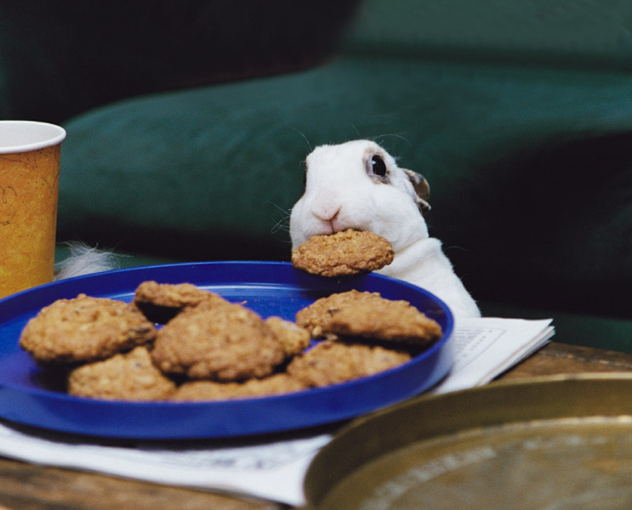
Questions are like cookies: If you don’t ask them, a bunny will eat them.

