Slide 1
Anatomy and Physiology
Part II

Slide 2
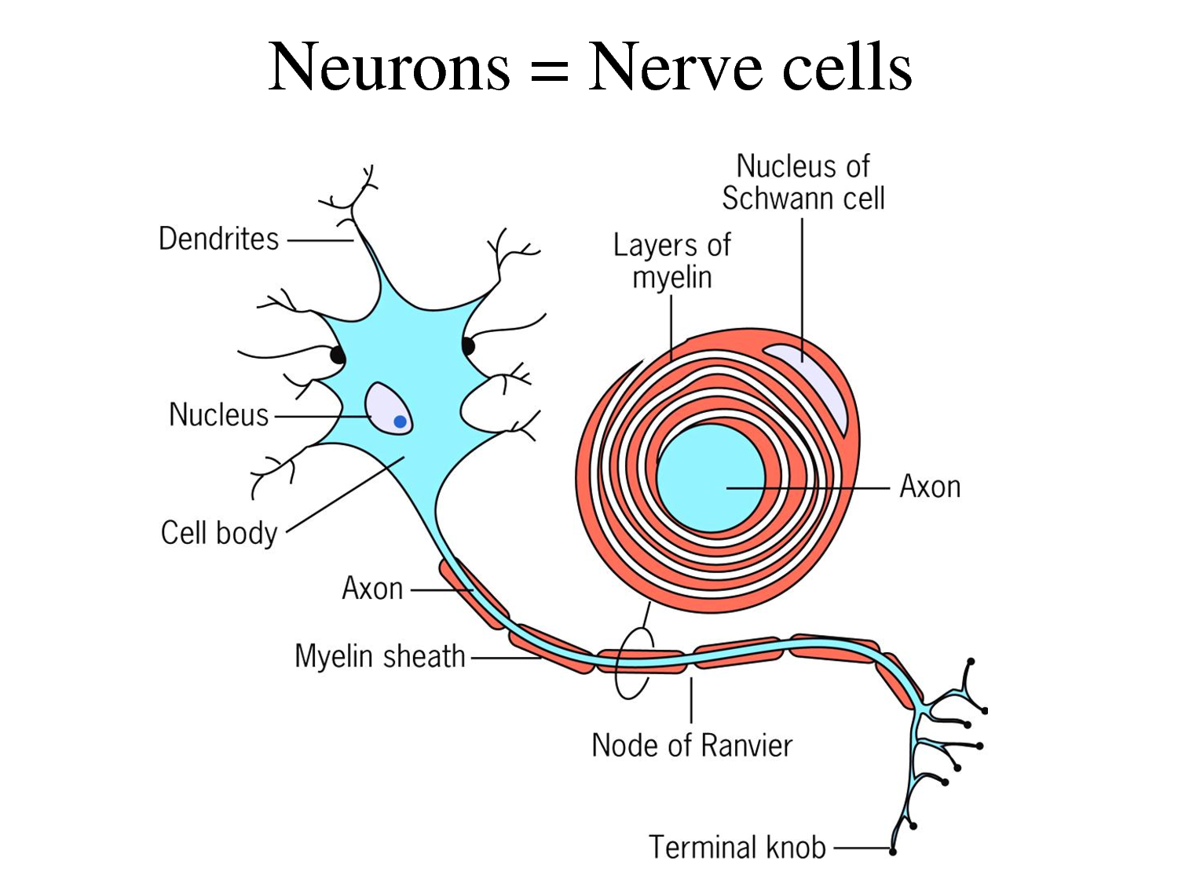
Nerve Anatomy

Slide 3
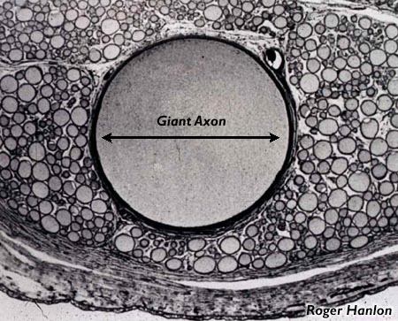
Axon
Like a tube
negative on the inside
_
+

Slide 4
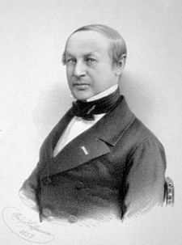
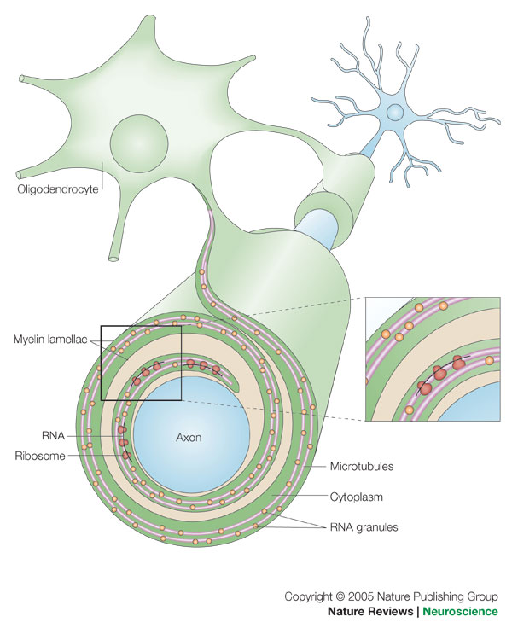
Myelin
Insulates like on a wire
Made by Schawann cells

Slide 5
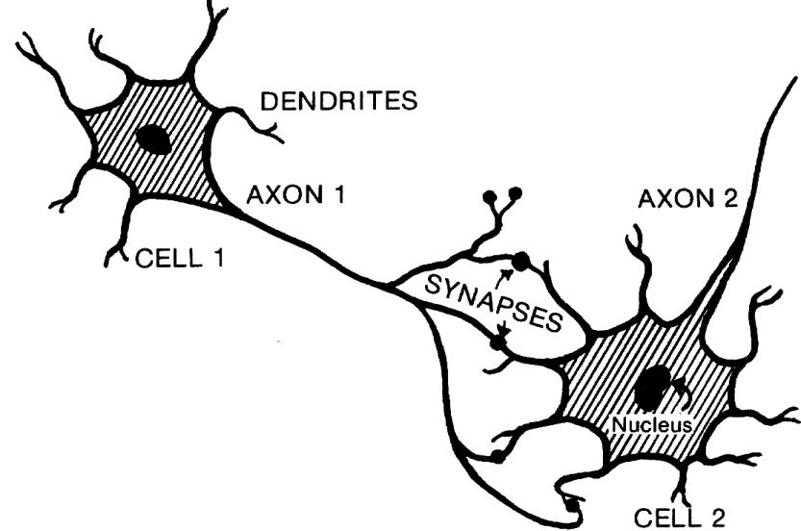
Dendrites
Communicate with other cells
Release neurotransmitters
Don’t quite touch!

Slide 6
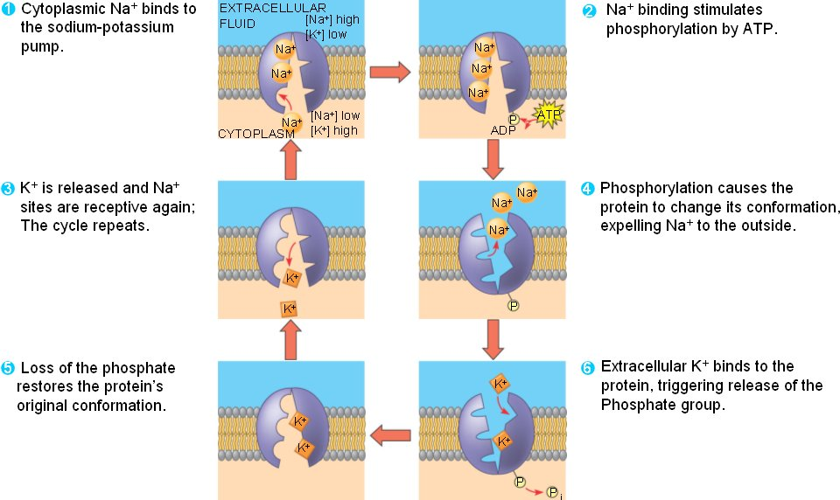
Nerve Physiology

Slide 7
Na+
Na+
K+
Na+
K+
K+
K+
K+
Na+
Na+
K+
K+
K+
K+
Na+
K+
K+
K+
Na+
Na+
K+
Na+

Slide 8
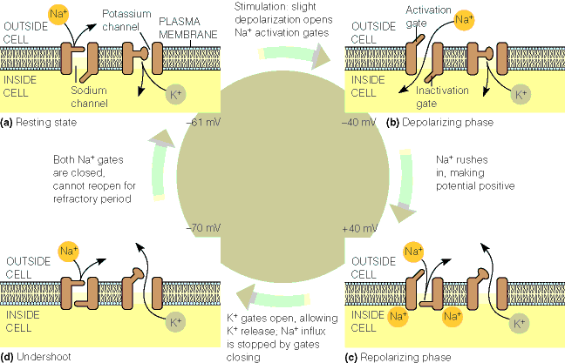
Action Potential

Slide 9
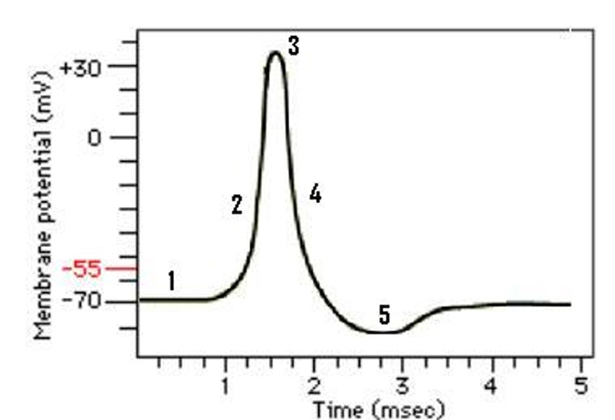
Action Potential
Afterhyperpolarization

Slide 10
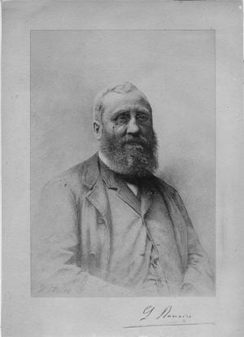
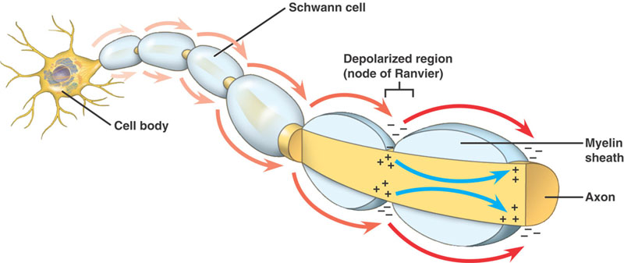
Saltatory Conduction

Slide 11
Speed:
Mylenated:
80 – 120 m/s (179 – 268 mi/hr)
Unmylenated:
About 1 m/s (2.2 mi/hr)

Slide 12
Implications
The Cranial Nerves (click) (click)
Can be affected by massage

